Slide 1
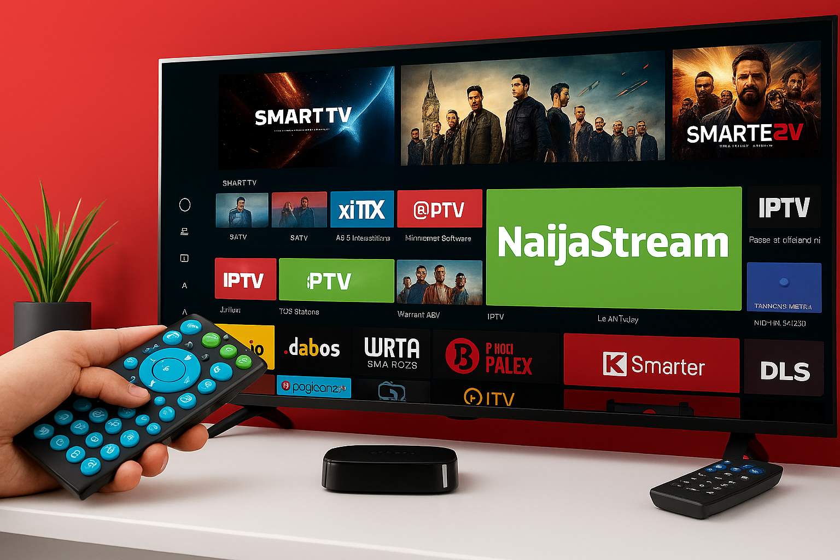
NaijaStream Subscription Analytics(video streaming business)
Insights into subscriber trends and viewing behavior
Notes:
AI-generated content may be incorrect. ---

Slide 2

Overview of NaijaStream
Subscription Plans
NaijaStream offers Basic, Standard, and Premium subscription tiers with monthly and annual billing options.
Geographic Reach
The platform serves users across Nigeria’s North, South, East, and West geopolitical zones from its Lagos headquarters.
Multi-Device Accessibility
Users can stream content on mobile phones, desktop computers, and smart TVs for broad accessibility.
Mission and Strategy
NaijaStream aims to deliver quality content while enhancing user engagement through data-driven strategies.
Notes:
--- This slide references information from the following file: https://ulster-my.sharepoint.com/personal/adebayo-ad_ulster_ac_uk/Documents/Microsoft%20Copilot%20Chat%20Files/NaijaStream%20PDF%20EXCEL.pdf NaijaStream is Nigeria’s indigenous video-streaming platform that offers a variety of subscription plans tailored to meet the entertainment needs of its diverse user base. The service provides three subscription tiers—Basic, Standard, and Premium—available on both monthly and annual billing cycles. Headquartered in Lagos, NaijaStream reaches audiences across Nigeria’s geopolitical zones: North, South, East, and West. Users access content through multiple devices including Mobile phones, Desktop computers, and Smart TVs. This broad accessibility ensures that NaijaStream remains a competitive player in the digital media landscape. The company’s mission is to deliver high-quality streaming content while optimizing user engagement and retention through data-driven strategies.

Slide 3

Key Characteristics of NaijaStream
Subscription-Based Model
NaijaStream offers Basic, Standard, and Premium subscription tiers tailored to diverse user needs and budgets.
Nationwide User Coverage
The platform operates across four major regions in Nigeria, ensuring wide and inclusive coverage.
Device Usage Distribution
User engagement is distributed with 50% on Desktop, 40% on Mobile, and 10% on Smart TVs.
Strong Financial Performance
NaijaStream has generated ₦12 million in revenue with strong monthly and annual recurring revenues indicating growth potential. High churn rate (~49%)
Notes:
--- This slide references information from the following file: https://ulster-my.sharepoint.com/personal/adebayo-ad_ulster_ac_uk/_layouts/15/Doc.aspx?sourcedoc=%7BE3F7B0B7-554E-4598-8291-D631F943A80D%7D&file=NAIJA%20STREAM%20EXCEL%20FILE%20(DASHBOARD,%20KPI,%20CLEAN%20DATA%20AND%20RAW%20DATA).xlsx&action=default&mobileredirect=true NaijaStream’s business model is defined by its subscription-based structure, offering three tiers—Basic, Standard, and Premium. Each tier caters to different user needs and price sensitivities. The platform operates across four major regions in Nigeria, ensuring nationwide coverage. Device usage statistics reveal that Mobile accounts for 40% of user engagement, Desktop for 50%, and Smart TV for 10%. Financially, the company has generated a total revenue of ₦12,099,800 from 2,000 orders. Monthly Recurring Revenue (MRR) stands at ₦498,000, while Annual Recurring Revenue (ARR) is ₦5,976,000. The Average Revenue Per User (ARPU) is ₦498,000, indicating strong monetization potential. These metrics highlight NaijaStream’s robust operational footprint and its capacity for scalable growth.

Slide 4

Major Problem Facing NaijaStream
High User Churn Rate
NaijaStream experiences a high churn rate of 49.35%, indicating many users discontinue their subscriptions.
Data Visibility Challenges
Lack of clear insights into regional subscriptions and device usage complicates understanding user behavior.
Revenue and Investment Impact
Inadequate data hinders revenue predictions and limits strategic content and retention investments.
Need for Proactive Retention
Targeted retention strategies based on comprehensive user data are essential to reduce churn and protect revenue.
Notes:
--- This slide references information from the following file: https://ulster-my.sharepoint.com/personal/adebayo-ad_ulster_ac_uk/Documents/Microsoft%20Copilot%20Chat%20Files/NaijaStream%20PDF%20EXCEL.pdf NaijaStream faces a significant challenge in managing user churn, which currently stands at a high rate of 49.35%. This issue is compounded by the lack of clear visibility into regional subscription dynamics, churn patterns, and device usage. These gaps in data insight lead to unpredictable revenue fluctuations and hinder strategic investments in content and retention initiatives. Without targeted interventions, NaijaStream risks losing valuable subscribers and revenue. Addressing this problem requires a comprehensive understanding of user behavior across different regions and devices, as well as the implementation of proactive retention strategies.

Slide 5

Objectives of the Analysis
Revenue Driver Insights
Analyze revenue by region, subscription tier, and device type to empower leadership with actionable insights.
At-risk User Identification
Identify user segments at risk of cancellation to enable targeted retention efforts and reduce revenue loss.
Subscriber Trends and ARPU
Track month-over-month subscriber trends and ARPU differences to optimize pricing and promotions.
Data-driven Decision Making
Leverage insights to enhance user engagement and maximize ROI through strategic decisions.
Notes:
--- This slide references information from the following file: https://ulster-my.sharepoint.com/personal/adebayo-ad_ulster_ac_uk/Documents/Microsoft%20Copilot%20Chat%20Files/NaijaStream%20PDF%20EXCEL.pdf The primary objectives of the analysis are to empower NaijaStream’s leadership with actionable insights into revenue drivers segmented by region, subscription tier, and device type. By identifying at-risk user segments, the company aims to deploy targeted retention tactics that minimize revenue loss due to cancellations. Additionally, the analysis seeks to uncover month-over-month subscriber trends and ARPU disparities, enabling the optimization of pricing strategies and promotional timing. These objectives are aligned with the broader goal of enhancing user engagement and maximizing return on investment through data-driven decision-making.

Slide 6
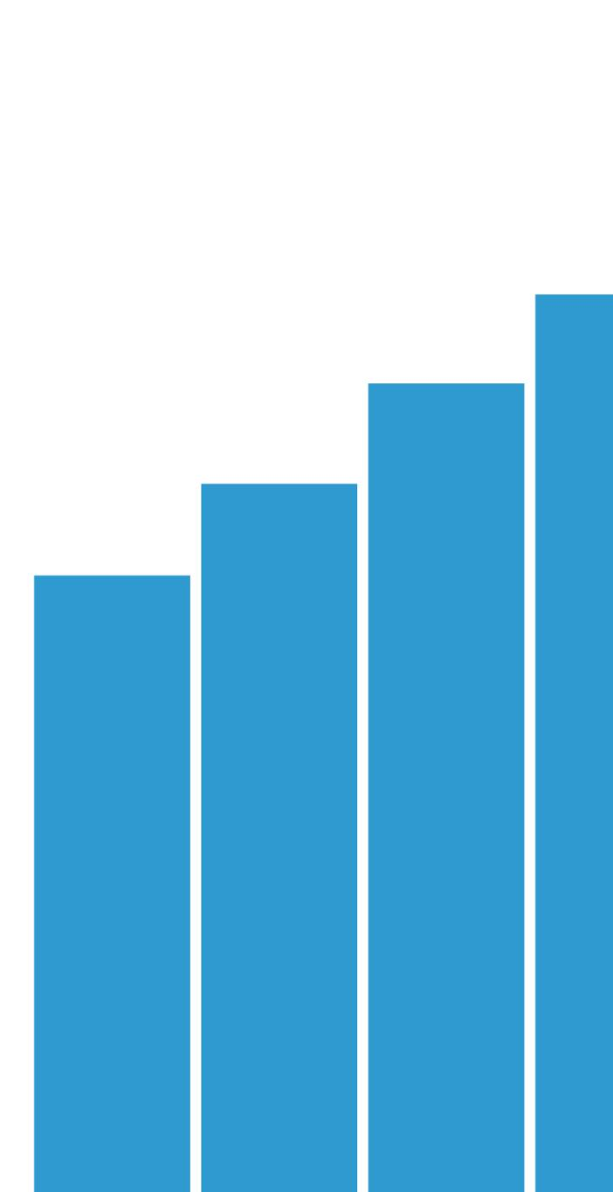
Specific Goals of the Visualization
Revenue and Order Metrics
Visualizations quantify total revenue, total orders, MRR, ARR, and ARPU to track financial performance.
Churn and Retention Analysis
The dashboard compares churn rate versus retention across subscription tiers to understand customer loyalty.
Device and Regional Insights
Visuals depict device usage distribution and regional revenue breakdowns, highlighting key market segments.
Top States and Growth Trends
The visualization identifies top revenue-generating states and tracks growth trends over time for strategic planning.
Notes:
--- This slide references information from the following file: https://ulster-my.sharepoint.com/personal/adebayo-ad_ulster_ac_uk/Documents/Microsoft%20Copilot%20Chat%20Files/NaijaStream%20PDF%20EXCEL.pdf The visualization component of the analysis is designed to address several key business questions. These include quantifying total revenue, total orders, MRR, ARR, ARPU, and churn rate. The dashboard also visualizes device usage distribution and regional revenue breakdowns. It provides insights into average revenue per subscription tier and compares churn versus retention across tiers. Additionally, the dashboard identifies top revenue-generating states and tracks growth trends over time. These visualizations serve as a strategic tool for monitoring performance and guiding business decisions.

Slide 7
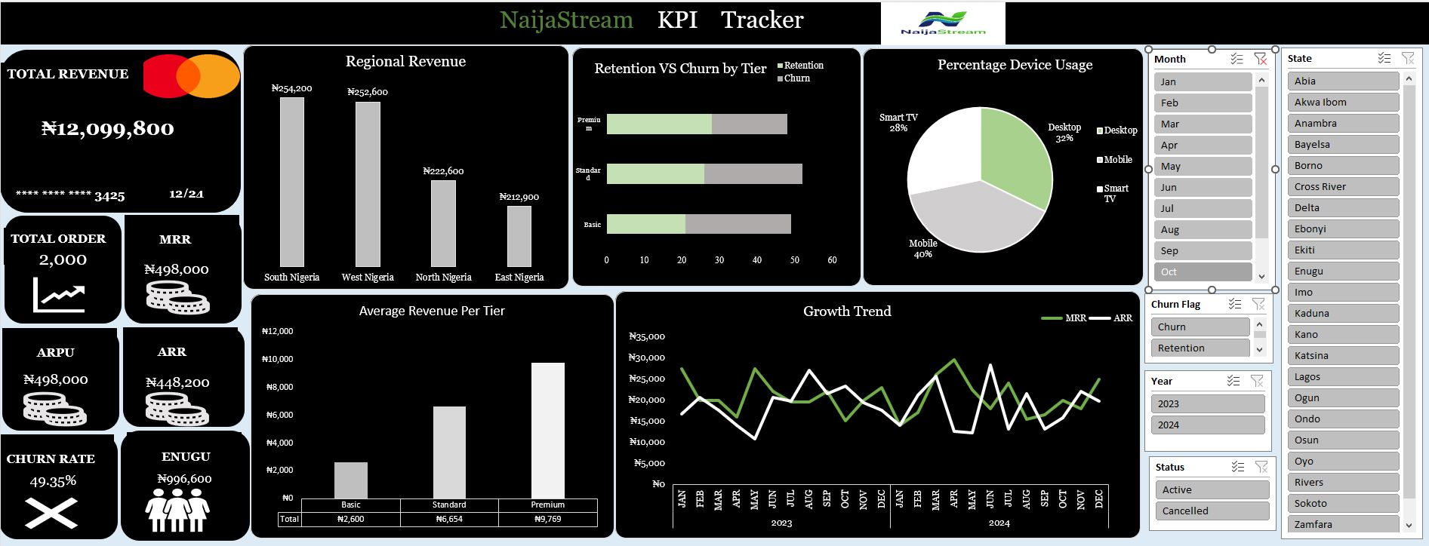
Snapshot of the NaijaStream DashBoard
Revenue and Order Metrics
Notes:
--- This slide references information from the following file: https://ulster-my.sharepoint.com/personal/adebayo-ad_ulster_ac_uk/Documents/Microsoft%20Copilot%20Chat%20Files/NaijaStream%20PDF%20EXCEL.pdf The visualization component of the analysis is designed to address several key business questions. These include quantifying total revenue, total orders, MRR, ARR, ARPU, and churn rate. The dashboard also visualizes device usage distribution and regional revenue breakdowns. It provides insights into average revenue per subscription tier and compares churn versus retention across tiers. Additionally, the dashboard identifies top revenue-generating states and tracks growth trends over time. These visualizations serve as a strategic tool for monitoring performance and guiding business decisions.

Slide 8

Critical Analysis and Insights
Revenue Distribution by Region
West Nigeria leads in revenue generation with ₦1.59 million, representing 27% of total recurring revenue.
User Tier and ARPU Insights
Premium users have 46% higher ARPU than average, while Basic users are 48% below, showing upsell potential.
Device Usage and Churn Rate
Mobile dominates with 47.8% active users; churn rate is high at 49.35%, especially among monthly subscribers.
Growth Trends and Strategy Needs
Fluctuating MRR and ARR trends highlight the need for more consistent user engagement strategies.
Notes:
--- This slide references information from the following file: https://ulster-my.sharepoint.com/personal/adebayo-ad_ulster_ac_uk/Documents/Microsoft%20Copilot%20Chat%20Files/NaijaStream%20PDF%20EXCEL.pdf,https://ulster-my.sharepoint.com/personal/adebayo-ad_ulster_ac_uk/_layouts/15/Doc.aspx?sourcedoc=%7BE3F7B0B7-554E-4598-8291-D631F943A80D%7D&file=NAIJA%20STREAM%20EXCEL%20FILE%20(DASHBOARD,%20KPI,%20CLEAN%20DATA%20AND%20RAW%20DATA).xlsx&action=default&mobileredirect=true The analysis reveals several critical insights into NaijaStream’s operations. West Nigeria emerges as the highest revenue-generating region, contributing ₦1.59 million or 27% of total recurring revenue. Premium tier users have an ARPU that is 46% above the overall average, while Basic tier users fall 48% below, indicating a strong upsell opportunity. Enugu, Lagos, and Kano states collectively generate ₦2.6 million, accounting for 21% of total revenue. Device usage analysis shows Mobile as the dominant platform with 47.8% of active users, followed by Desktop at 32.68% and Smart TV at 19.55%. The churn rate is notably high at 49.35%, particularly among monthly plan users. Growth trends in MRR and ARR exhibit fluctuations, suggesting the need for more consistent engagement strategies. These insights provide a foundation for targeted interventions and strategic planning.

Slide 9
Recommendations for Improvement
Localized Marketing Strategies
Target marketing and content in West, North, and East Nigeria to maximize revenue from top-performing regions.
Enhance Premium Plans
Offer loyalty perks such as bonus months and early content access to increase annual Premium subscriber value.
Targeted Upsell Campaigns
Encourage Basic users to upgrade through personalized upsell campaigns to boost average revenue per user.
UI/UX Improvements on Mobile
Improve mobile platform user interface and experience to increase engagement and retention among half of active users.
Churn Reduction Tactics
Use in-app win-back messages and email reminders to reduce churn among monthly plan subscribers.
Notes:
--- This slide references information from the following file: https://ulster-my.sharepoint.com/personal/adebayo-ad_ulster_ac_uk/Documents/Microsoft%20Copilot%20Chat%20Files/NaijaStream%20PDF%20EXCEL.pdf Based on the analysis, several strategic recommendations are proposed to enhance NaijaStream’s performance. First, localize marketing and content strategies in top-performing regions such as West, North, and East Nigeria to capitalize on their combined revenue potential. Second, enhance the value proposition of annual plans for Premium subscribers by offering loyalty perks like bonus months or early access to content. Third, implement targeted upsell campaigns for Basic tier users to encourage upgrades and boost ARPU. Fourth, prioritize UI/UX improvements on mobile platforms, which account for nearly half of active users, to increase engagement and retention. Lastly, deploy churn-reduction campaigns for monthly plan users, including in-app win-back messages and email reminders. These recommendations aim to reduce churn, increase revenue, and improve overall user satisfaction.

Slide 10

Additional Insights for Impact
Data-Driven Dashboards
Using data-driven dashboards enables real-time decision-making and effective performance monitoring.
KPI Tracking Benefits
Regular KPI tracking helps identify emerging trends and potential risks early for proactive action.
Continuous Improvement Culture
Fostering continuous improvement through analytics empowers teams to innovate and adapt quickly.
Strategic Integration Impact
Integrating analytics insights into strategy enhances competitive advantage and long-term sustainability.
Notes:
--- This slide references information from the following file: https://ulster-my.sharepoint.com/personal/adebayo-ad_ulster_ac_uk/Documents/Microsoft%20Copilot%20Chat%20Files/NaijaStream%20PDF%20EXCEL.pdf To further enhance the impact of the presentation and strategic planning, additional insights are suggested. Leveraging data-driven dashboards can facilitate real-time decision-making and performance monitoring. Regular KPI tracking enables the early identification of emerging trends and potential risks. Cultivating a culture of continuous improvement through analytics empowers teams to adapt quickly and innovate effectively. These practices not only support operational efficiency but also foster a proactive approach to market changes and user needs. Integrating these insights into NaijaStream’s strategic framework can significantly elevate its competitive advantage and long-term sustainability.

